Slide 1
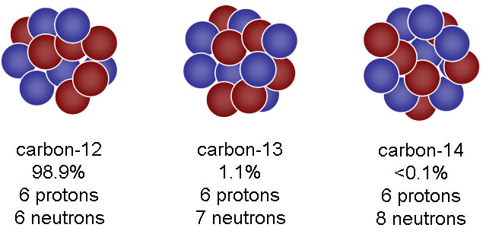
Isotopes
Unit 2
Lesson 2
Proton Neutron

Slide 2
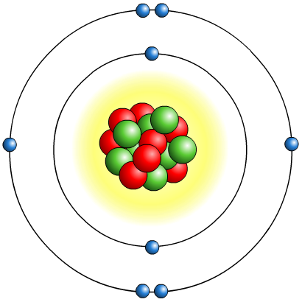
Recap: the atom
The nucleus is:
made up of protons and neutrons
positively charged because of the protons
dense – it contains nearly all the mass of the atom in a tiny space.
Electrons are:
very small and light, and negatively charged
able to be lost or gained in chemical reactions
found thinly spread around the outside of the nucleus, orbiting in layers called shells.

Slide 3
Today’s Aim
Unit 2
Lesson 2
By the end of this lesson I will be able to calculate the relative atomic mass (A_{r}) of an element from its isotopes

Slide 4

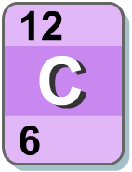
Atomic Number
Each element has a definite and fixed number of protons. This is called the proton number.
This means that atoms of any particular element always contain the same number of protons. For example:
hydrogen atoms always contain 1 proton
carbon atoms always contain 6 protons
magnesium atoms always contain 12 protons.
The atomic number (A, or proton number) is always the smaller of the two numbers shown in the periodic table.

Slide 5
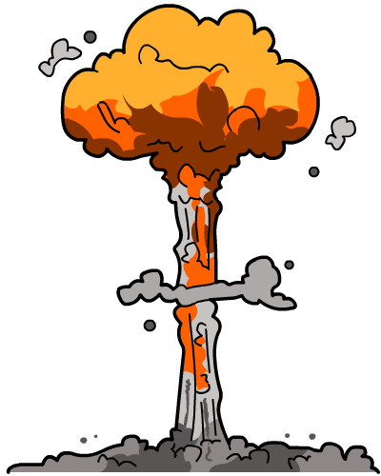
Atomic Number
Because each element has a definite and fixed number of protons, if the number of protons changes, then the atom becomes a different element.
Changes in the number of particles in the nucleus (protons or neutrons) are very rare. They only take place in nuclear processes such as:
radioactive decay
nuclear bombs
nuclear reactors.

Slide 6
On mini whiteboards, draw the nucleus of these atoms
11
5
4
2
12
6
B
boron
He
helium
C
carbon
N
N
+
N
N
N
+
+
+
+
+
N
N
+
N
N
N
N
+
+
+
+
N
+
example
+
N
N

Slide 7
What’s the difference?
Proton Neutron

Slide 8
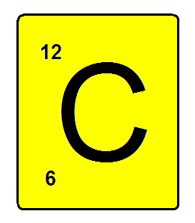
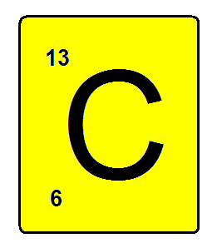
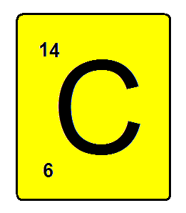
Isotopes
Isotopes are atoms of the same element that contain different numbers of neutrons.
6 protons
6 protons
6 protons
6 NEUTRONS
7 NEUTRONS
8 NEUTRONS

Slide 9
Isotopes
Notice that the mass number is different. How many neutrons does each isotope have?
16
17
18
O
O
O
8
8
8
Each isotope has 8 protons – if it didn’t then it just wouldn’t be oxygen any more.

Slide 10
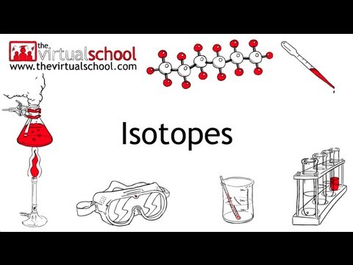
Isotopes Video

Slide 11
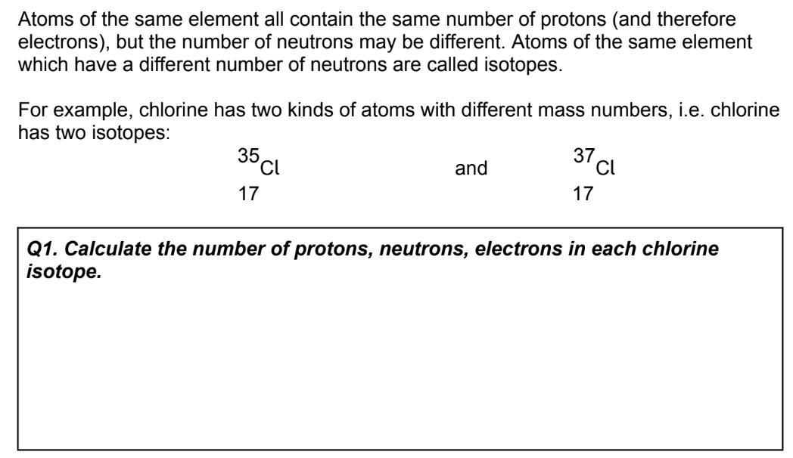
Read and answer all questions on page 12
chlorine-35
17 protons
17 electrons
18 neutrons
chlorine-37
17 protons
17 electrons
20 neutrons

Slide 12
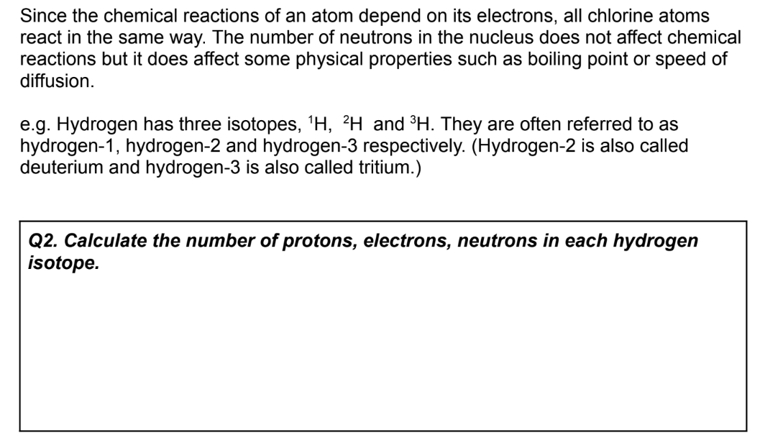
Read and answer all questions on page 12
hydrogen-1
1 protons
1 electrons
0 neutrons
hydrogen-2
1 protons
1 electrons
1 neutrons
hydrogen-3
1 protons
1 electrons
2 neutrons

Slide 13
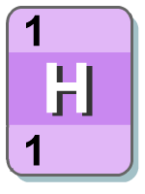

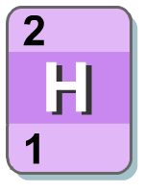



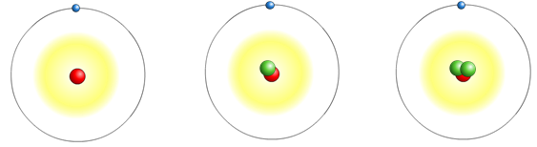
Isotopes of hydrogen
Hydrogen-1 makes up the vast majority of the naturally occurring element but two other isotopes exist.
hydrogen
deuterium
tritium
1 proton
1 proton
1 proton
0 neutrons
1 neutrons
2 neutrons
1 electron
1 electron
1 electron

Slide 14
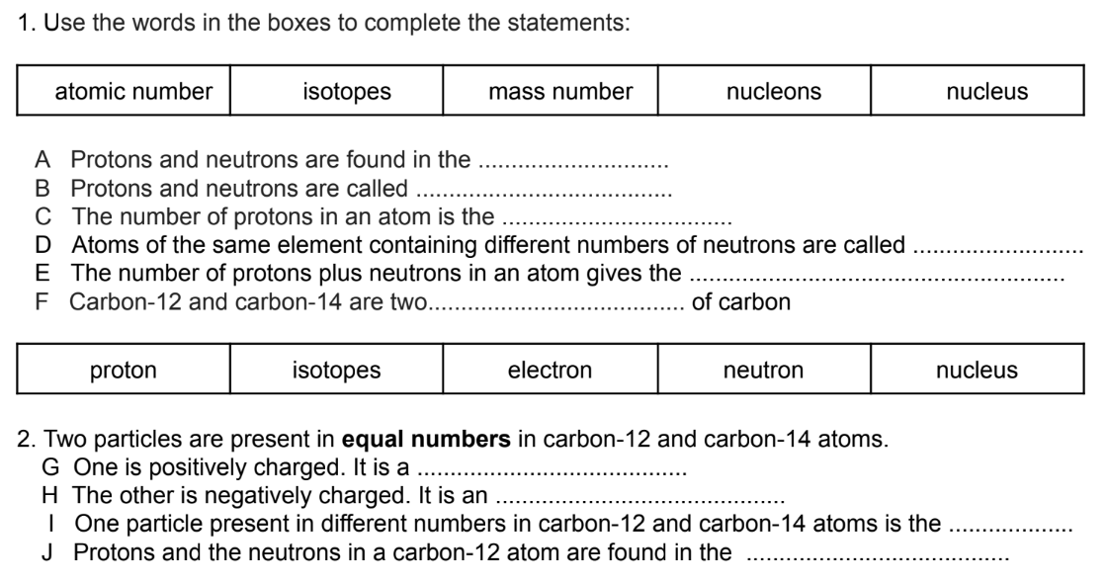
Complete all questions on page 14
nucleus
nucleons
atomic number
isotopes
mass number
isotopes
protons
electrons
neutrons
nucleus

Slide 15
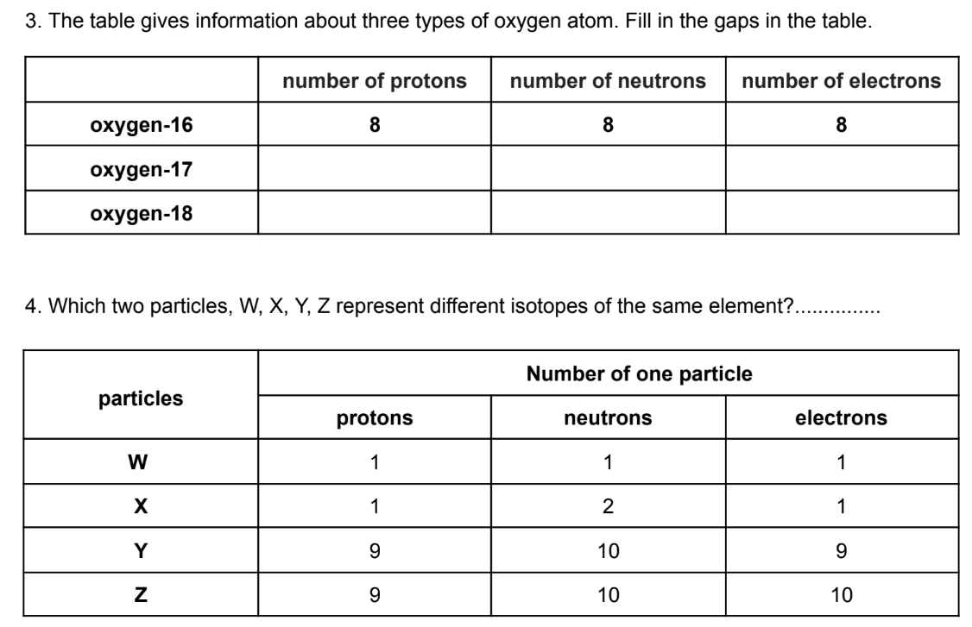
Complete all questions on page 14
8 9 8
8 10 8
W and X

Slide 16
Atomic Mass vs. Relative Atomic Mass
These two terms mean different things!
The atomic mass of an atom is simply the total number of protons and neutrons in that atom.
The relative atomic mass (A_{r}) is different!
Look up the A_{r} of chlorine from the periodic table:
Why is it unusual compared to most other elements?
Are there any other elements with this same property?

Slide 17
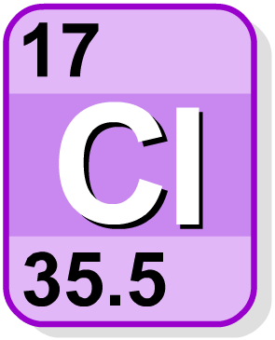
Isotopes
Relative atomic mass (A_{r}) is not always a whole number.
For example, the A_{r} of chlorine is 35.5.
35.5
The A_{r} for element is the weighted average of the atomic masses of all the isotopes of an element.
e.g. chlorine has two isotopes:
chlorine-35 (75%) and chlorine-37 (25%).
17
A_{r} of chlorine
= (75% x 35) + (25% x 37)
= (0.75 x 35) + (0.25 x 37)
= 26.25 + 9.25
= 35.5

Slide 18
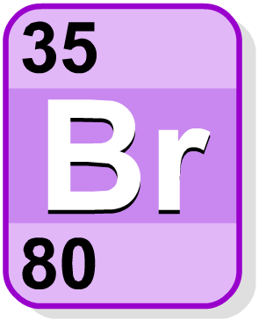
Calculating A_{r}
To calculate the A_{r} of an element, multiply the percentage of each isotope by its atomic mass and then add these together. For example: naturally-occurring bromine is composed of two isotopes:
bromine-79 (50.5%) and bromine-81 (49.5%).
What is the A_{r} of naturally-occurring bromine?
A_{r}
= (50.5% x 79) + (49.5% x 81)
= (0.505 x 79) + (0.495 x 81)
= 39.895 + 40.095
= 79.99
80
?
35
This figure can be rounded up

Slide 19
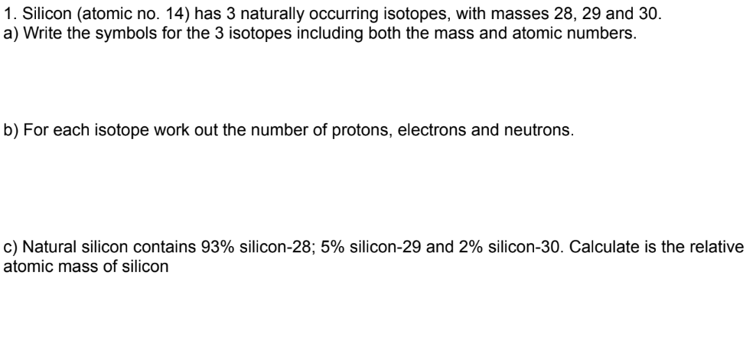
Complete all questions on page 13
silicon-28
²⁸Si
silicon-29
²⁹Si
silicon-30
³⁰Si
14 protons
14 electrons
14 neutrons
14 protons
14 electrons
15 neutrons
14 protons
14 electrons
16 neutrons
A_{r} Si
= (93% x ²⁸Si) + (5% x ²⁹Si) + (2% x ³⁰Si)
= (0.93 x 28) + (0.05 x 29) + (0.02 x 30)
= 26.04 + 1.45 + 0.6
= 28.09

Slide 20
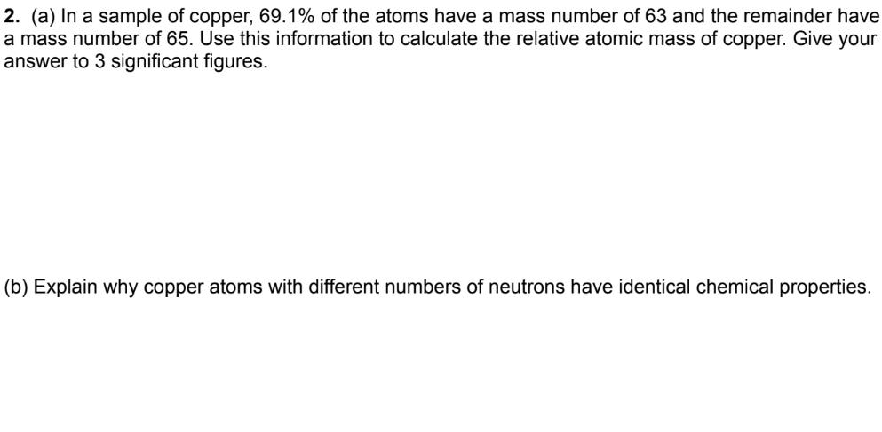
Complete all questions on page 13
A_{r} Cu
= (69.1% x ⁶³Cu) + (30.9% x ⁶⁵Cu)
= (0.691 x 63) + (0.309 x 65)
= 43.5 + 20.1
= 63.6
The number of neutrons in an atom does not affect the chemical properties. It is only the electron configuration that determines the chemical properties of an atom.

Slide 21
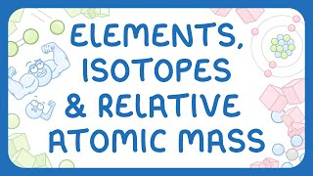
Another video to help explain isotopes

Slide 22
Plenary: more practice questions
Lithium has two naturally occurring isotopes: ⁶Li (7% abundance) and ⁷Li (93% abundance). Calculate the relative atomic mass of lithium. Give your answer to 1 decimal place.
Chromium has four naturally occurring isotopes, and their masses and natural abundances are shown in below. Calculate the relative atomic mass of chromium to two decimal places.
Isotope Natural Abundance
⁵⁰Cr 4.35 %
⁵²Cr 83.79 %
⁵³Cr 9.50 %
⁵⁴Cr 2.36 %
6.9
52.03

Slide 23

What you need to know
Topic 1
Lesson 2
Syllabus Content
1.16
know what is meant by the terms atomic number, mass number, isotopes and relative atomic mass (A_{r}).
1.17
be able to calculate the relative atomic mass of an element (A_{r}) from isotopic abundances.
My Learning

